Slide 1
FRC Robot Mechanical Principles
Continuing Subjects:
Review understanding from last week
Robot agility and maneuverability?
Chassis types & options
Speed and Torque?
Torque vs. Speed
Gear ratios
Breakaway torque limit
2 speed
3 CIM vs. 2 CIM
3 CIM + 2 Speed – vs. 3 CIM single speed
Wheels: Friction

Slide 2
FRC Engineering/Design
Review:
Every year our Strategic Design has called for:
“Fast, Stable, Maneuverable With Good, Pushing Power”
How do you get maneuverable – agile – quick turning?
How do you get stable?
How do you get both?
How do you get Fast?
How do you get good pushing power?
How do you get both?
Chassis & Drive train layout defined by middle of week 1?
An example of an 8WD
agile & stable tank drive layout

Slide 3
Friction
Classical Friction Theory
Torque at wheel imparts a “Drive force” at wheel carpet contact point
This is reacted by a “Friction Force” of up to the “Friction coefficient” times the weight on the wheel
The friction coefficient is a characteristic of the materials involved
If the Drive force is greater than the Friction force, the wheels will slip
The maximum Torque that can be transmitted
by the drivetrain is the “Breakaway Torque”
that creates a Drive force equal the
Friction coefficient x Weight on wheel
= μ * m * g
Torque
Weight = mass*gravity = m*g
Friction reaction force
Drive Force = Torque/radius
=μ*m*g

Slide 4
Drive Motors, Transmissions, Sprockets and Wheel Diameter
How to translate speed of motor to speed of robot?
Motor speed inputs into transmission with a gear ratio
Motor load results in speed loss
Transmission output to sprockets connected by chain
Ratio of sprocket teeth decreases speed
Overall Ratio includes motors, transmissions, sprockets/belts, wheel diameter
Wheel
Sprocket
Transmission
Motor

Slide 5
Drive Motors, Transmissions, Sprockets and Wheel Diameter
Simple Transmission Gearbox (as in the CIMple Gear box)
2 CIM motor input
Output Speed
= 5300 * 14/65
= 1150 RPM
65 teeth
5300 RPM
CIM Motor Free Speed
14 teeth
14 teeth
5300 RPM
CIM Motor Free Speed

Slide 6
Basic Relationships - Review
Wheel / Transmission Mechanics
Torque = Radius x Force = T (in-lbs)
Rotational speed = ω (rpm)
Velocity = v = (ω*2*Π*r)/(60 *12) (ft/sec)
Frictional Coefficient = μ “empirical” – test wheel grip to carpet, with weight
Maximum Traction Force = F_{T} = μ x W (weight of the robot = mg)
Maximum Torque at wheel that can be transferred by friction
T_{μ}= μ * W * radius
Max torque delivered by motor is at stall
Torque decreases with speed
T
F_{w}
r
v
W
ω
F_{t}

Slide 7
Drive Motors, Transmissions, Sprockets and Wheel Diameter
Wheel
(RPM)
Velocity = v =
(ω*2*Π*r)/(60 *12) (ft/sec)
Sprocket
Transmission
Motor

Slide 8
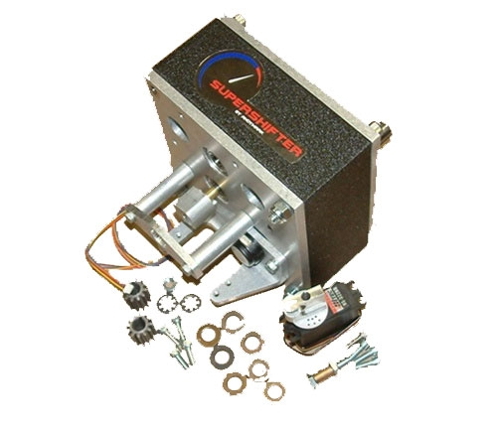
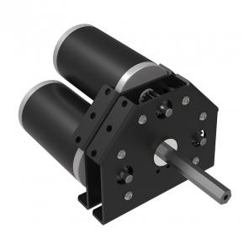
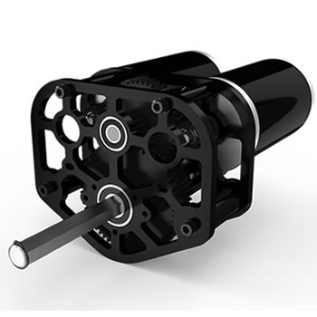
COTS Drive Transmission Options

Slide 9
Drive Motors, Transmissions, Sprockets and Wheel Diameter
Spreadsheet simulations allow quick iterations to explore different combinations of gearboxes, sprockets and wheel diameters.

Slide 10
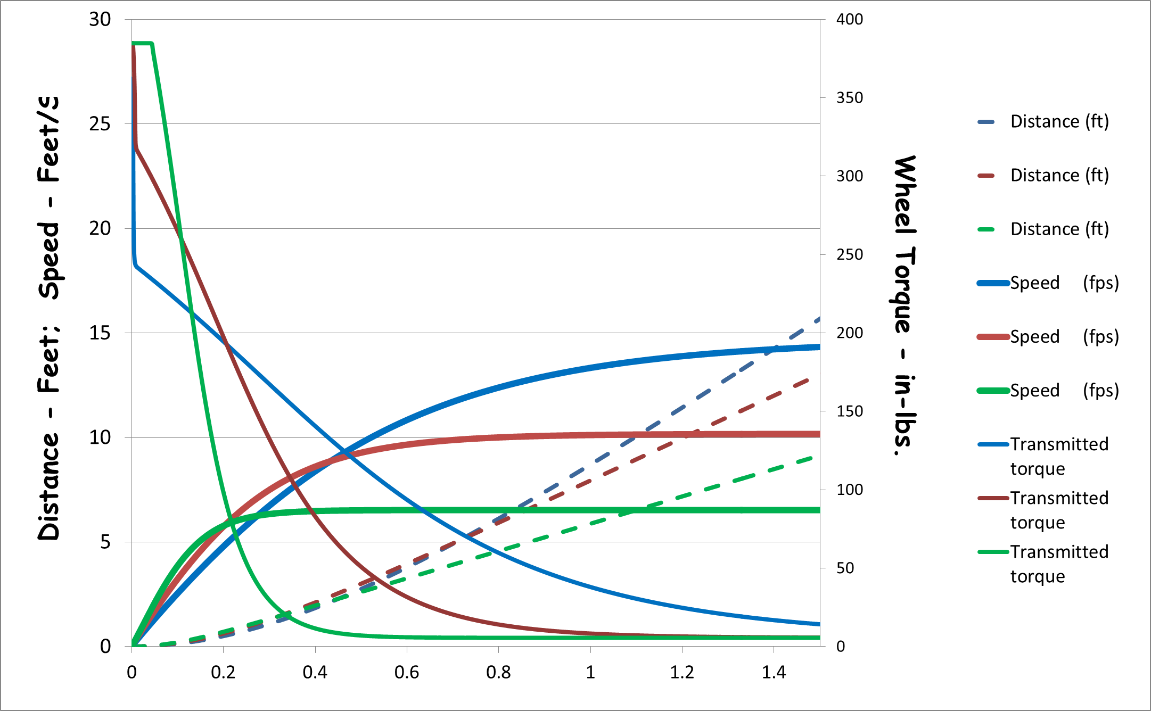
Gear Ratio Effects
Gear Ratio Optimization Trades Off Speed and Torque
2CIMS in each of 2 single speed gearboxes
Higher gear ratio
Lower max speed
More low end torque
May not be able to use all of Torque?
Lower Gear Ratio
Higher max speed
Less max torque
May not ever get to top speed?
Torque provides acceleration
T = F * r = m * a * r
increasing speed
Torque decreases with speed
Wheel friction limits amount of Torque that can be transmitted without spinning wheels
Only get advantage of higher gear ratio if friction is high
For Instance: μ = 0.9 there is no advantage to a gear ratio above 7.3
For typical μ = 1.1 What is optimum gear ratio?
μ = 1.3
μ = 1.1
μ = 0.9
Torque=>
<= Speed
<= Distance
Time (seconds)

Slide 11
Gear Ratio Effects
2 Speed Gearbox Allows Optimization of Speed and Torque
2CIMS in each of 2 two speed gearboxes
Desire to “shift” when acceleration (or Torque) crosses
Here shift from 11.43 ratio to 5.03 ratio at about 25 in-lbs and 16 fps
Very slight advantage in distance / time
If μ = 1.1 then get up to 320 in-lbs torque at low speed
And up to 15 fps!
Only is advantage if shifted at right times
Driver shifting is difficult
Automation opportunity?
Read speed on encoder and shift automatically?
μ = 1.3
μ = 1.1
μ = 0.9
Torque=>
<= Speed
<= Distance
Time (seconds)

Slide 12
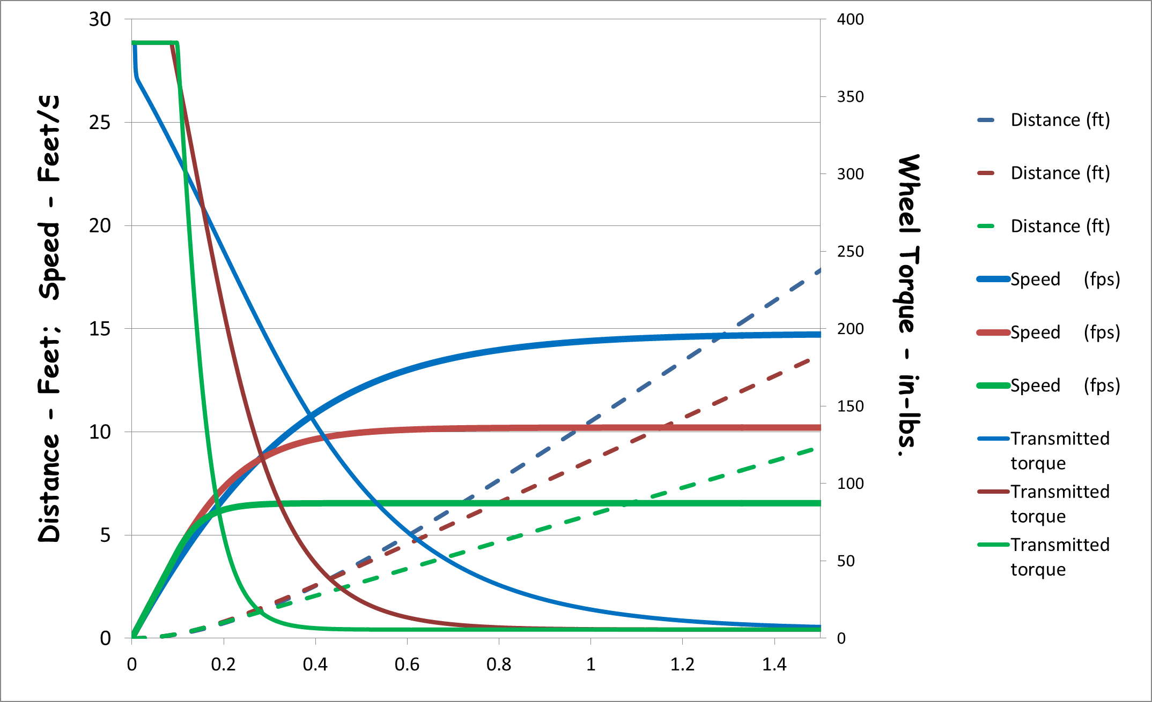
2 CIM vs 3 CIM Drive
3 CIM / Gearbox Drive Eliminates Need For 2 Speed Gearbox
3 CIMs provide 50% more torque at any gear ratio
Minimal benefit for 2 speed gearbox
Friction becomes more important than gear ratio
Can have ~14 fps robot (very fast) and have max transmittable torque
3 CIMs provide quicker acceleration – getting more distance vs. time.
Equal to 2 CIM – 2 speed
3 CIMS in each of 2 single speed gearboxes
μ = 1.3
μ = 1.1
μ = 0.9
Torque=>
<= Speed
<= Distance

Slide 13
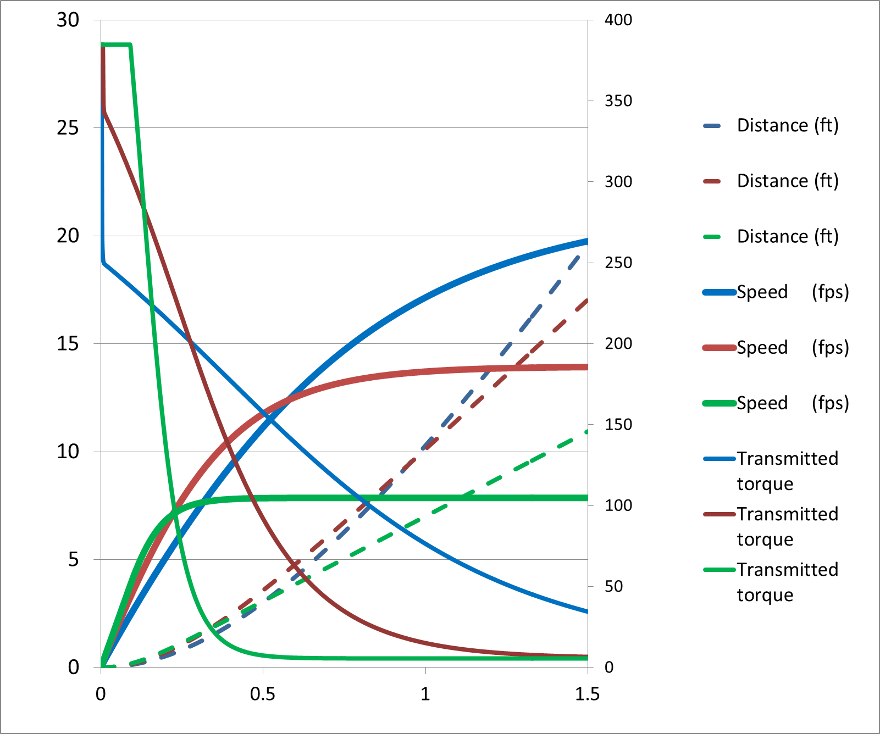
2 CIM vs 3 CIM Drive
When May 3 CIM – 2 Speed Make Sense?
μ = 1.3
Low gear ratio – high speed
High gear ratio set at level of max useful torque benefit
and not trip breakers
Here for μ = 1.2, Ratio~ 9:1
Low gear maintains high acceleration
Makes difference only if accelerating over 15 feet distance
At 20 feet may get up to
3-5 foot advantage
May not be controllable
μ = 1.1
μ = 0.9
Torque=>
<= Speed
<= Distance

Slide 14
Drive Simulation
Allows Convenient Evaluation Of Different Drive Train Configurations
Useful to understand trends
But make sure to anchor to test data
Includes considerations for:
Speed loss coefficient – how much slower motor is under load
Free speed is 5300 RPM, loaded speed ~ 4300 RPM (81%)
May be dependent on gear ratio – further test data needed
Torque accelerates speed, but torque reduces with speed
Speed desired called by voltage
Voltage drops when load is first applied, current spike
Simulation
Iterative time step solution - excel
Test data can be taken to improve simulations
Spreadsheets from team 33 and 148 (JVN) used and here-bye credited
Modified both in calculations and display.

